Slide 1
Decision Trees and Random Forest Classifier

Slide 2
Decision Trees
Weather
Sunny
Cloudy
Rainy
Decision trees are a type of machine learning model used for both classification and regression by making sequential decisions looking at one feature at a time.
Very simple, very intuitive and easy to understand
Nonlinear model
Fast prediction speed
Slow training time, expensive process
Prone to overfitting if your tree has too many layers
Reduce the number of layers aka “pruning” the tree. Therefore, we won’t use all the features. How do we ensure we use the most important features to build the tree?

Slide 3
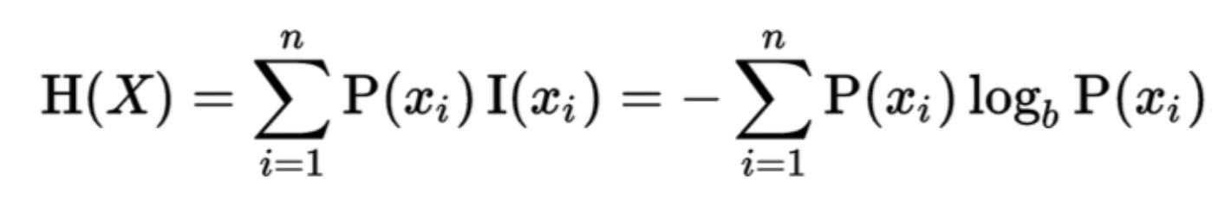
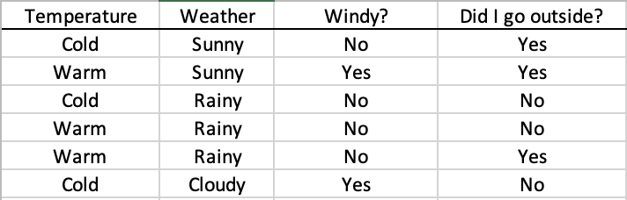
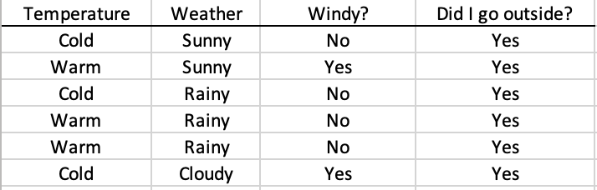
Decision Trees – Entropy & Information Gain
Entropy – the measure of chaos, or measure of homogeneity.
Probability of outcome (i)
Number of possible outcomes
Entropy = 1
Entropy = 0

Slide 4
Decision Trees – Entropy & Information Gain
Information Gain – The change in average entropy after splitting the data through a feature
H = 1
Weather
Sunny
Cloudy
Rainy
H = 0
H = 0
H = 0.92
Average Entropy = (2/6)*0 + (1/6)*0 + (3/6)*0.92 = 0.45
Information Gain = 1 – 0.46 = 0.54
Intuitively, information gain tells us how much a certain split will help us solve our problem.
“How much information can we get out of a single split”.

Slide 5
H = 1
Weather
Sunny
Cloudy
Rainy
H = 0
H = 0
H = 0.92
3+(2+2+2)+(1+1+1+1+1+1)
Average Entropy = (2/6)*0 + (1/6)*0 + (3/6)*0.92 = 0.46
Information Gain = 1 – 0.46 = 0.54
H = 1
H = 1
Windy?
Temperature
Yes
No
Cold
Warm
H = 1
H = 1
H = 0.92
H =0.92
Average Entropy = (2/6)*1 + (4/6)*1 = 1
Average Entropy = (3/6)*0.92 + (3/6)*0.92 = 0.92
Information Gain = 1 – 1 = 0
Information Gain = 1 – 0.92 = 0.080

Slide 6
Decision Trees – Entropy & Information Gain
To build decision trees, we calculate the information gain for every feature at each node. We “split” the tree based on which feature offers the largest information gain.
In our example, the weather feature offers the highest information gain, therefore we start off our tree by splitting by weather.
Weather
Sunny
Cloudy
Rainy

Slide 7
Weather
H = 0.92
Sunny
Cloudy
Rainy
H = 0
H = 0
Go Outside
Stay Inside
?
?

Slide 8
H = 0.92
Rainy
Cold
Warm
H = 0
H = 1
Average Entropy = (1/3)*0 + (2/3)*1 = 0.667
Information Gain = 0.92 – 0.667 = 0.25
H = 0.92
Rainy
Therefore, our split at the ”Rainy Node” would be the temperature
Not Windy
H = 0.92
Average Entropy = 0.92
Information Gain = 0.92 – 0.92 = 0

Slide 9
Our Resulting Decision Tree
Weather
H = 0.92
Sunny
Cloudy
Rainy
H = 0
H = 0
Go Outside
Stay Inside
H = 0
Cold
Warm
H = 0.667
Stay Inside
50% stay inside, 50% go outside
This is where your classification threshold comes in

Slide 10
What is the Gini Impurity Index?
Proxy for how often a randomly chosen data point would be incorrectly labeled.
Very similar to entropy: 1 – p₁² – p₂² – …
It’s computationally faster than entropy because the log function is computationally expensive
It’s said to be a weaker/simpler version of entropy but in practice there is very little difference between using Gini vs. entropy to build your decision tree.

Slide 11
Random Forest
Type of ensemble learning model where a bunch of weak models are aggregated to form a more powerful model
Specifically, a Bootstrap Aggregating model (aka Bagging)
Can be used for both regression and classification.

Slide 12
Bootstrap Aggregating
You train multiple decision trees by taking random samples of the data with replacement. This means one decision tree might have a certain data point occurring multiple times in its sample.
In some cases (not sure if it’s always the case), there is random sampling done to decide which of the features to keep in each tree.
This process is called bootstrapping
You end up with multiple trees trained on different samples.
The results of every tree will be aggregated to give you a final result. Averaged for regression, tallied for classification.

Slide 13
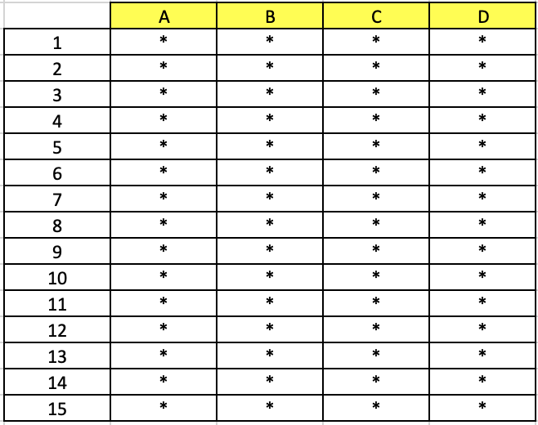
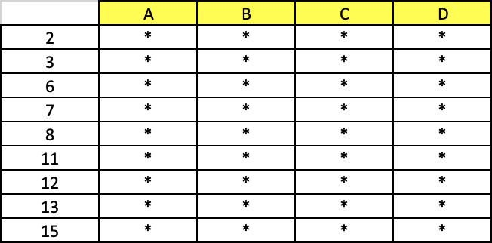
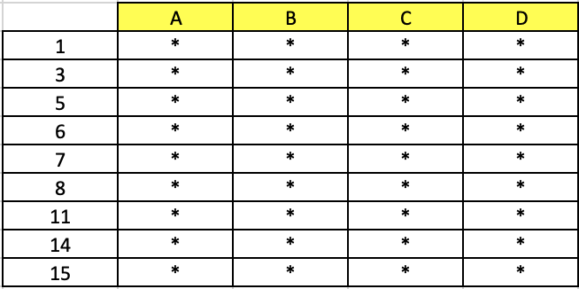

New Data
A
Predict
C
B
Spam
Spam
Ham
Spam
C
Predict
Bootstrapping
A
Spam
Spam
Spam
Spam
Ham
A
Predict
C
Ham
Ham
Spam
Ham
Aggregate

Slide 14
Bagging continued..
By training each tree separately on different samples, each tree might have high variance, but the overall random forest will have lower variance without increasing the bias. This helps avoid overfitting.
Simply put, Bagging is when you aggregate the predictions of several base models trained on bootstrapped subsets of your training data in order to decrease the impact of overfitting.

Slide 15
Random Forest
Has the same pros and cons as a decision tree except:
It is less interpretable than a decision tree though still fairly easy to explain
A single decision tree can be somewhat unstable (changing 1 data point can cause a drastic change in the tree). A random forest doesn’t have that problem
Slower training time than decision tree
Still has potential to overfit but not nearly as much as a decision tree

Slide 16
What is out of bag error?
It’s a way of estimating the test error of a bagging model.
You take row 1 of the data and you predict the results in only the decision trees that did not train with row 1.
You then aggregate the results and see if you predicted row one correctly.
You do this with every row of the data and see how many of the results were predicted correctly and incorrectly.

Slide 17
Boosting - Adaboost
Feature A
Spam
Ham
Stump (Decision tree with 1 node with 2 leaves ). They are weak learners (bad at prediction).
Boosting - basically training weak models sequentially where each model tries to correct the previous model.
AdaBoost – Uses stumps. In the first stump, all observations are weighted equally. The next stumps will put more weight on the observations that were incorrectly predicted by the previous stumps.
In AdaBoost, the decision stumps that make better predictions have more say in the final result than other decision stumps.

Slide 18
Bagging vs. Boosting
In Bagging models, each decision tree is made in parallel and independent of each other.
In Boosting models, decision trees are made sequentially where the errors of the first stump influences how the next stumps are made.
In Bagging models, each decision tree has the same influence in making the final prediction.
In Boosting models, certain stumps have more influence than other stumps in making the final prediction.

Slide 19
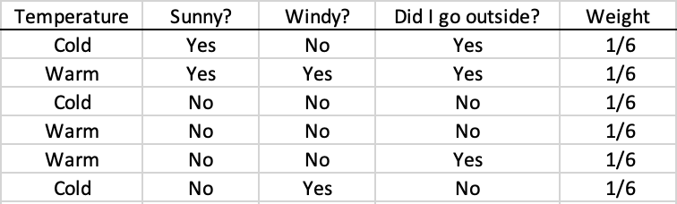
Adaboost Example
Note: all columns need to be one-hot-encoded to do Adaboost
All rows start off with the same weight
Use Information Gain or Gini Index to find the column that helps us make the best prediction.
Sunny? (I.G. = 0.46), Temperature (I.G. = 0.082), Windy? (I.G. = 0.0)
Sunny?
Yes
No
Go Outside
Stay Inside
Correct: 2
Incorrect: 0
Correct: 3
Incorrect: 1

Slide 20
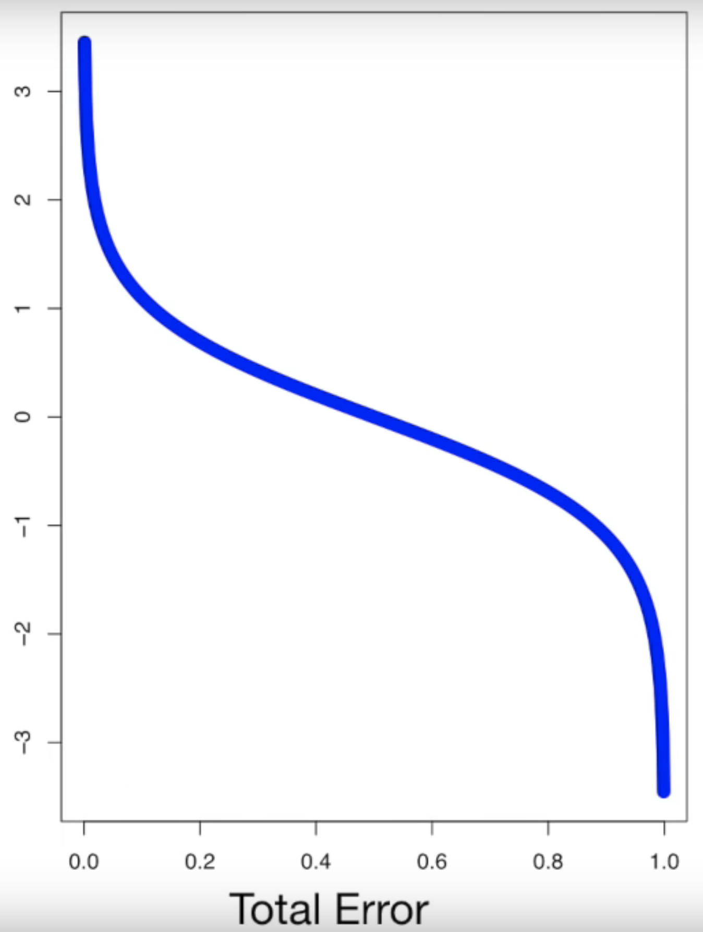
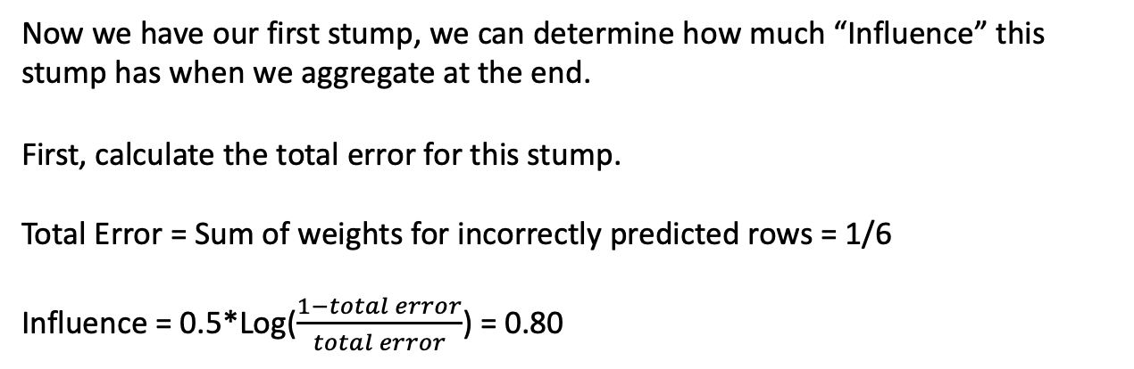
Sunny?
Yes
No
Now we have our first stump, we can determine how much “Influence” this stump has when we aggregate at the end.
First, calculate the total error for this stump.
Total Error = Sum of weights for incorrectly predicted rows = 1/6
Influence = 0.5*Log($\frac{1−total error}{total error}$) = 0.80
Go Outside
Stay Inside
Correct: 2
Incorrect: 0
Correct: 3
Incorrect: 1
When the total error is low, it means this stump does a good job and therefore we give it more influence
When the total error is 0.5, it means this stump is basically flipping a coin and therefore contributes almost nothing and so the influence is 0
When total error is high, it means the stump is prediction everything wrong, so we want to do the opposite of everything the stump says.

Slide 21
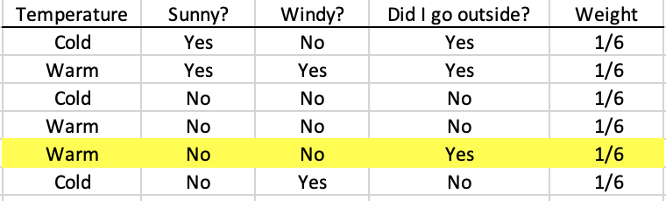
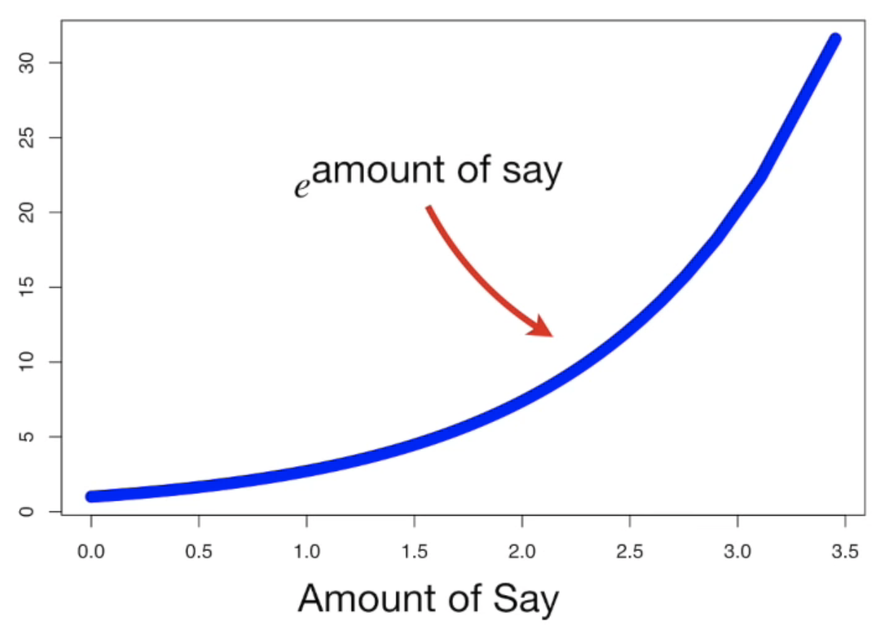
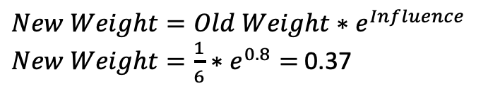

Now we need to update the weights of each sample by increase the weight of the sample we got wrong and decreasing the weight of the samples we got right.
Increase sample weight for incorrect predictions:
$$New Weight=Old Weight∗e^{Influence}$$
$New Weight=\frac{1}{6}∗e^{0.8}=$0.37
When the previous stump has a lot of Influence, we know it is good at predicting the correct results, therefore, we want it to change our weights by a greater amount.
$$e^{Influence}$$
When the previous stump has no Influence, we know it is bad at predicting the correct results, therefore, we don’t want it to change our weights by much
Influence

Slide 22
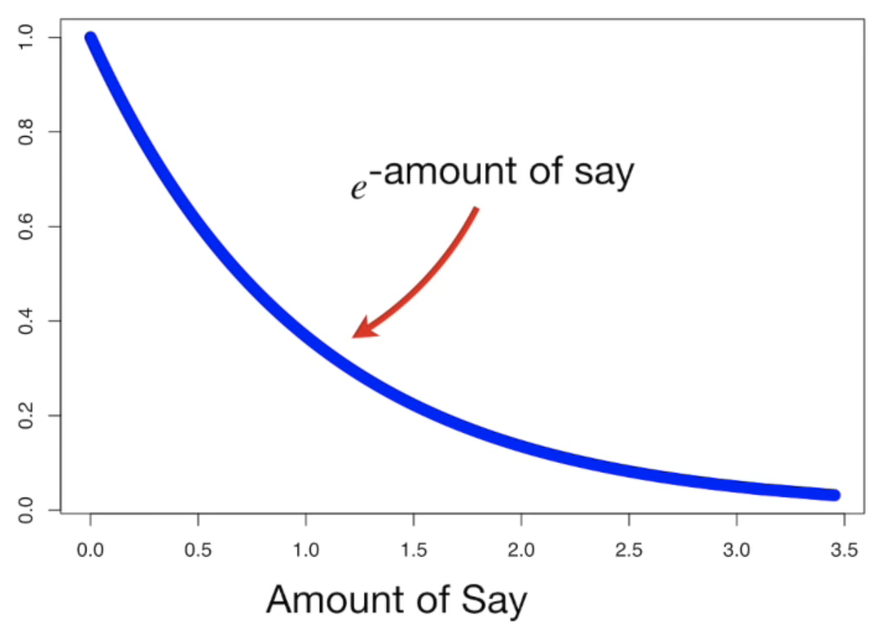
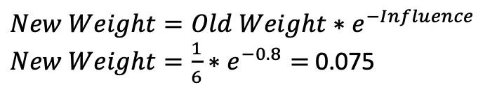

Decrease sample weight for correct predictions:
$$New Weight=Old Weight∗e^{−Influence}$$
$New Weight=\frac{1}{6}∗e^{−0.8}=$0.075
When the previous stump has no Influence, we know it is bad at predicting the correct results, therefore, we don’t want it to change our weights by much
$$e^{−Influence}$$
When the previous stump has a lot of Influence, we know it is good at predicting the correct results, therefore, we want it to change our weights by a greater amount.
Influence

Slide 23
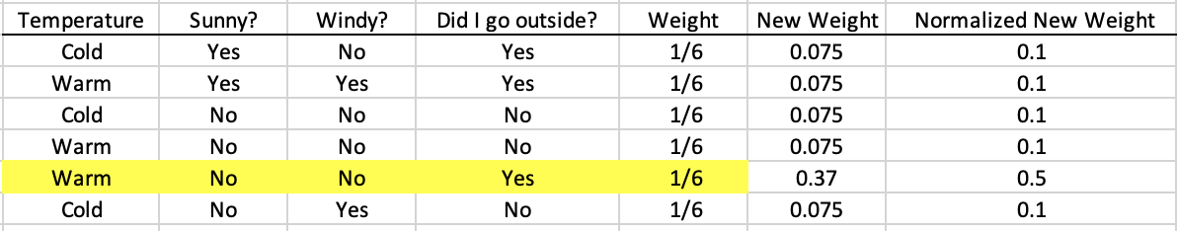
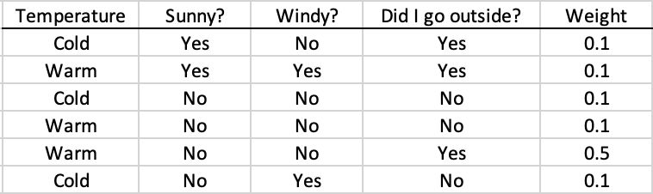
Sum = 0.745
Now adds up to 1
Normalize by dividing by 0.745
0.1+0.1+0.1
0.1+0.1+0.5
Temperature I.G. = 1 – ( 0.3*0.92 + 0.7*0.92 ) = 0.082
Sunny I.G. = 1 – ( 0.2*0 + 0.8*0.81) = 0.35
Windy I.G. = 1 – (0.2*1 + 0.8*1) = 0
Therefore, second stump will also use Sunny

Slide 24
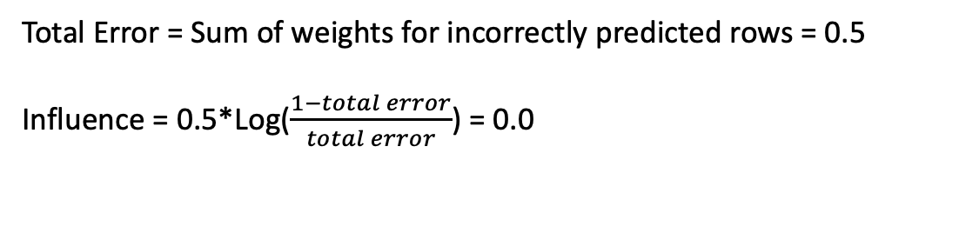
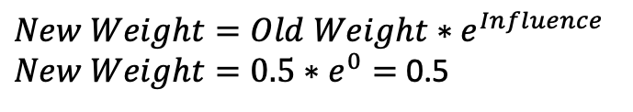
Second Stump:
Sunny?
Yes
No
Go Outside
Stay Inside
Correct: 2
Incorrect: 0
Correct: 3
Incorrect: 1
Total Error = Sum of weights for incorrectly predicted rows = 0.5
Influence = 0.5*Log($\frac{1−total error}{total error}$) = 0.0
$$New Weight=Old Weight∗e^{Influence}$$
$New Weight=0.5∗e^{0}=$0.5
Tables don’t change and we’re stuck. Original stump has all the influence, so we end up with a model that says “if it’s sunny, go outside, if not, stay inside”… which based on our tiny data set isn’t that bad…

Slide 25
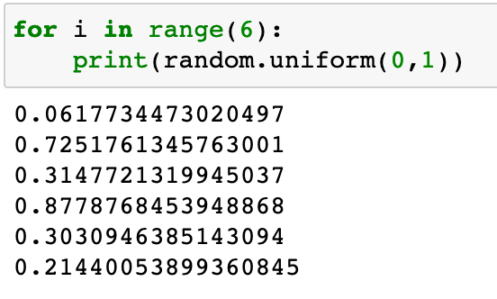
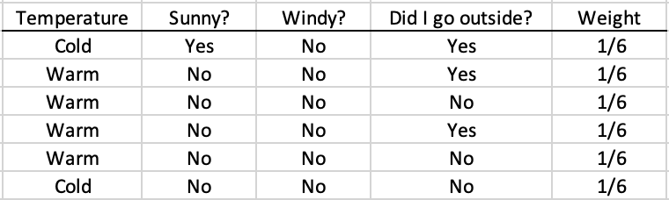
Alternative to slide 23
Alternative method is to randomly create a new data set with the weights as probabilities.
0
0.1
Randomly pick numbers between 0 and 1, do it 6 times:
0.2
0.3
0.4
0.9
1.0
Calculate information gain with new data set of equal weights.
To do something like this, it would be ideal to start with a larger dataset

Slide 26
Adaboost vs Random Forest
Which is better?
It really depends on your data. There are many instances where either one outperforms the other
I’ve read that Adaboost works better for data that has high dimensionality (many features) – not personally confirmed
However, Adaboost is highly computationally expensive (sequential not parallel) and so if there isn’t a large advantage to using Adaboost, it’s not efficient to pick it over Random Forest
Adaboost might also be more prone to overfitting because it puts a lot of emphasis on incorrect predictions. In my example data, I decided to go outside one time when it wasn’t sunny (maybe because I had to), Adaboost put a lot of emphasis on that data point when maybe we just want to absorb it as an outlier occurrence.
Random Forest works better with smaller data sets (outliers have more power in small data sets)
Random Forests are easier to explain and interpret. Also provides a level of feature selection.

